Slide 1

Day 1
Git & GitHub
14-05-2024
Notes:
https://www.freepik.com/

Slide 2
Table Of Contents
Software development lifecycle
01
SDLC before DevOps
02
Source code management
03
Git & GitHub Hands-on
04

Slide 3

Software Development Lifecyle
Notes:
https://get.pxhere.com/photo/job-office-collaboration-design-interior-design-white-collar-worker-conversation-learning-employment-hand-desk-furniture-interview-building-team-gesture-management-1535603.jpg
https://pixnio.com/free-images/2017/08/29/2017-08-29-16-04-13-1000x667.jpg
https://pixnio.com/free-images/2020/09/01/2020-09-01-09-33-31-1200x800.jpg
https://live.staticflickr.com/65535/50938102118_144ee02523_b.jpg

Slide 4







Requirements Analysis
Monitoring & Maintenance
Software Design
SDLC
Software Development
Software Deployment
Testing & QA

Slide 5
SDLC Before DevOps
Notes:
https://get.pxhere.com/photo/job-office-collaboration-design-interior-design-white-collar-worker-conversation-learning-employment-hand-desk-furniture-interview-building-team-gesture-management-1535603.jpg
https://pixnio.com/free-images/2017/08/29/2017-08-29-16-04-13-1000x667.jpg
https://pixnio.com/free-images/2020/09/01/2020-09-01-09-33-31-1200x800.jpg
https://live.staticflickr.com/65535/50938102118_144ee02523_b.jpg

Slide 6
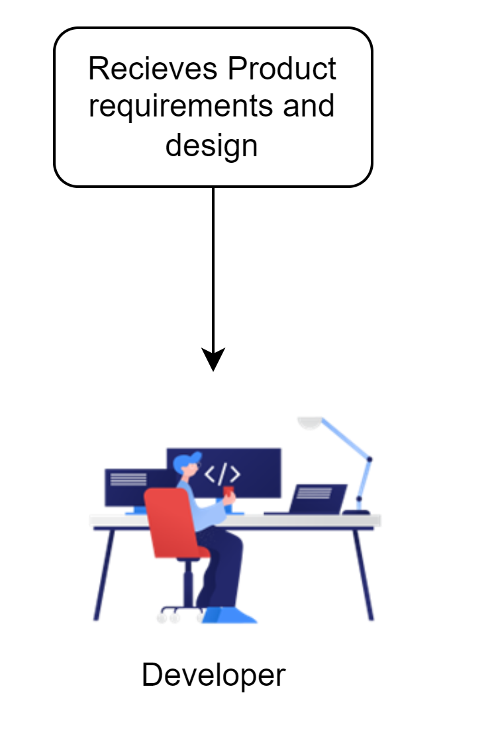
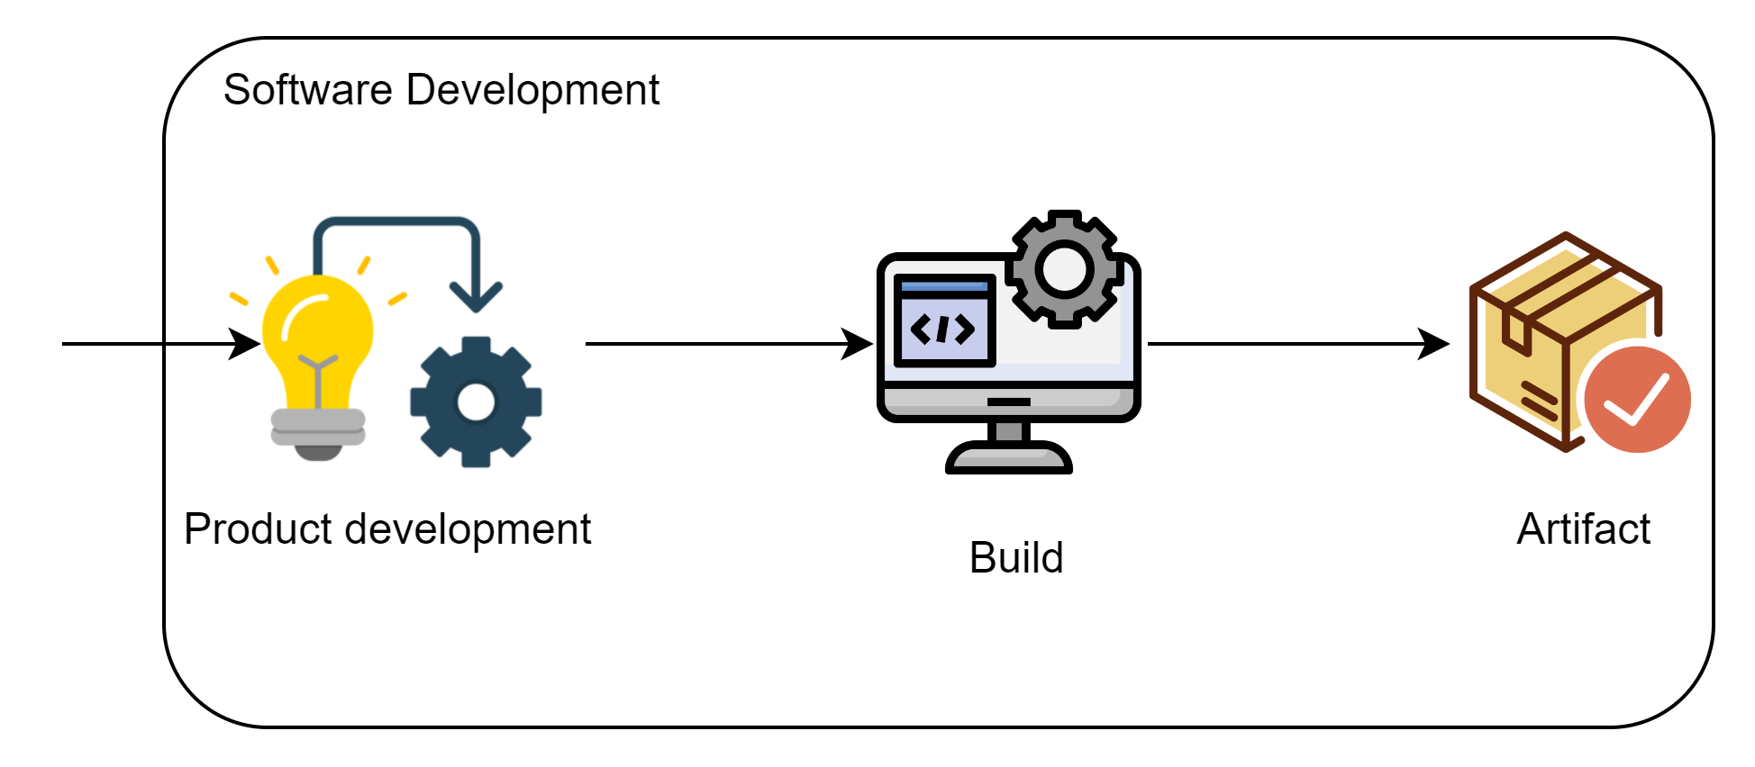

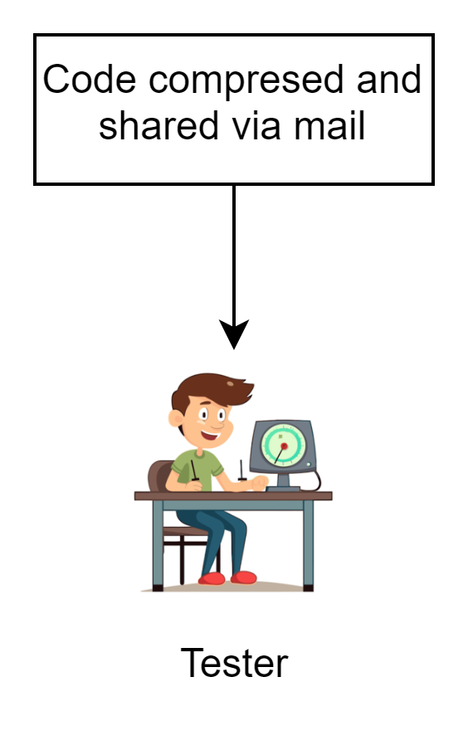
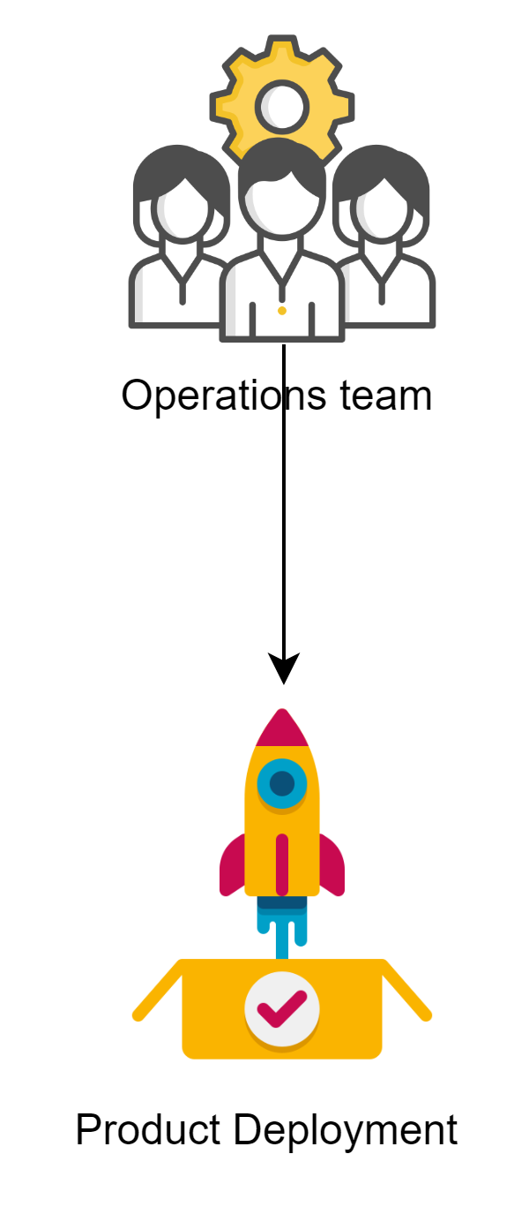
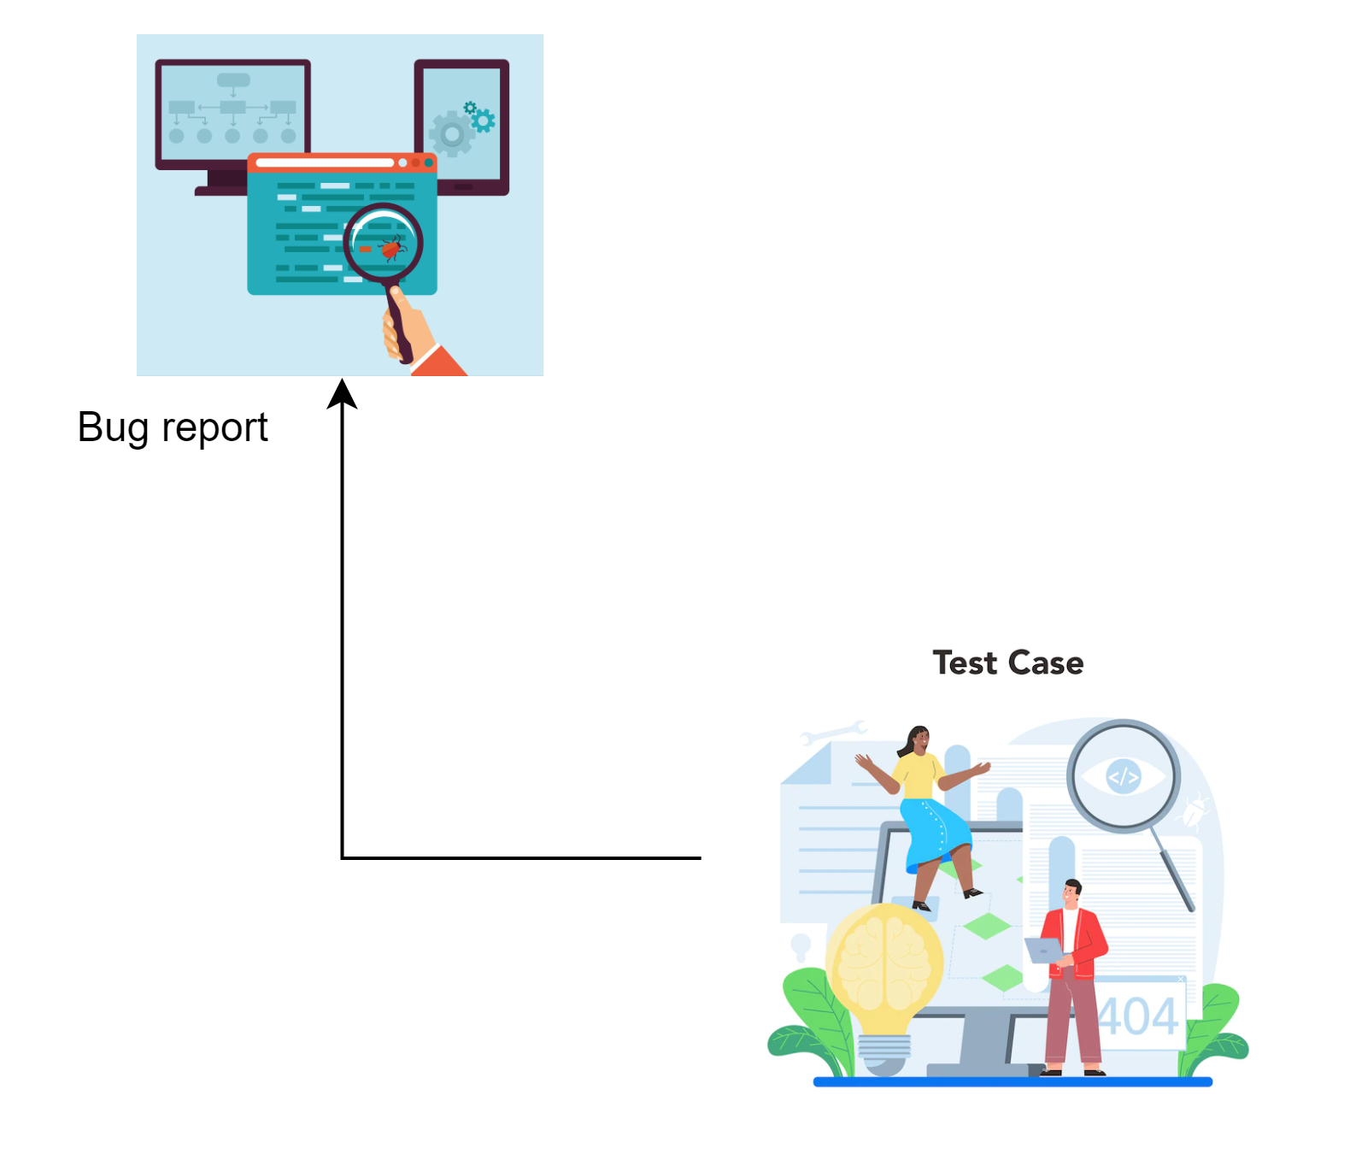

Slide 7




Pros
Simple and Straightforward
Low Initial Cost
Learning Opportunity
Error-Prone:
Time-Consuming
Reduced Productivity
High risk of human error, which can lead to deployment failures, downtime, or critical issues in the production environment.
Manual steps are often slow and labor-intensive, leading to longer deployment times.
Inefficient for frequent or large-scale deployments
Diverts valuable time and resources from development and other high-priority tasks.
Manual processes can lead to burnout and frustration among team members.
Cons

Slide 8
Pros
Simple and Straightforward
Low Initial Cost
Learning Opportunity
Error-Prone
Time-Consuming
Reduced Productivity
Cons

Slide 9
Source Code Management
Notes:
https://get.pxhere.com/photo/job-office-collaboration-design-interior-design-white-collar-worker-conversation-learning-employment-hand-desk-furniture-interview-building-team-gesture-management-1535603.jpg
https://pixnio.com/free-images/2017/08/29/2017-08-29-16-04-13-1000x667.jpg
https://pixnio.com/free-images/2020/09/01/2020-09-01-09-33-31-1200x800.jpg
https://live.staticflickr.com/65535/50938102118_144ee02523_b.jpg

Slide 10


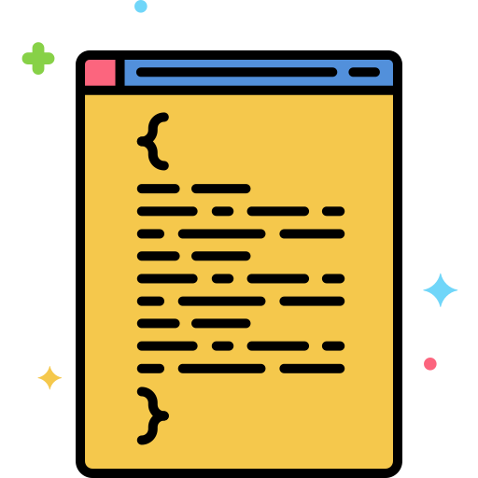


Calculator
Bob
Alice
Feature-code-X
Sharing code via e-mail
Feature-code-Y
Text editor

Slide 11
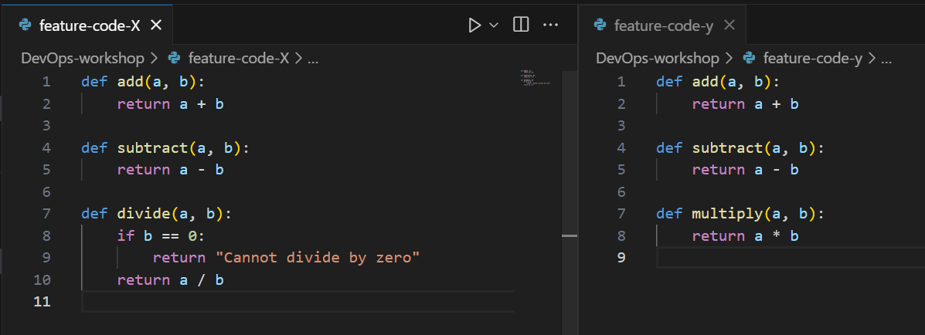




Compare two versions of a single file
Identify the difference
Merge the code manually
Review the compatibility

Slide 12




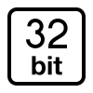



What is Git?
Distributed Version Control System
Branching and Merging
Git is a distributed version control system that helps software developers manage changes to the code over time.
Version Tracking
Collaboration
Speed and Performance
Open-Source and community-driven

Slide 13
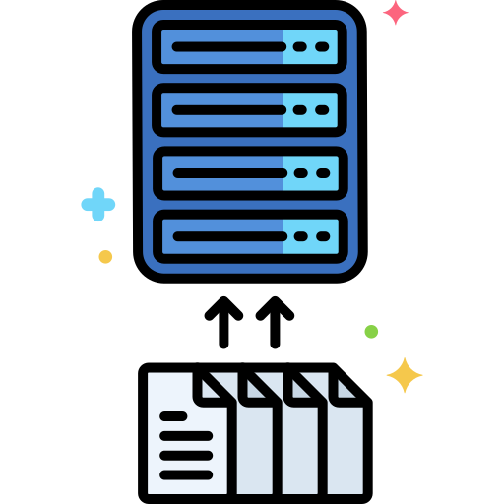




Key Concepts in Git
A snapshot of your project files at a specific point in time.
Combining changes from different branches.
Repository
Branch
Remote
Commit
Merge
A storage location for your project's files and their revision history.
A parallel version of your repository, used to develop features in isolation.
A version of your repository stored on another computer or server, like GitHub.

Slide 14
Pros
Distributed Version Control
Efficient Branching and Merging
Strong Community and Ecosystem
Git is a distributed version control system, meaning every developer has a full copy of the repository including its history.
Git has a large, active community and is widely adopted in the industry.
Git makes it easy to create, manage, and merge branches.
Sharing code
Lack of Security
Performance Issues with Large Repositories
It is difficult to host repositories online using git, making it difficult for developers to share and contribute to projects.
Git does not have any security built in, It does not allow us to authenticate and create private repositories. Enterprises control over access and code security.
Git can experience performance issues with very large repositories or binary files.
Cons

Slide 15
Pros
Distributed Version Control
Efficient Branching and Merging
Strong Community and Ecosystem
Sharing code in the network
Lack of Security
Performance Issues with Large Repositories
Cons

Slide 16
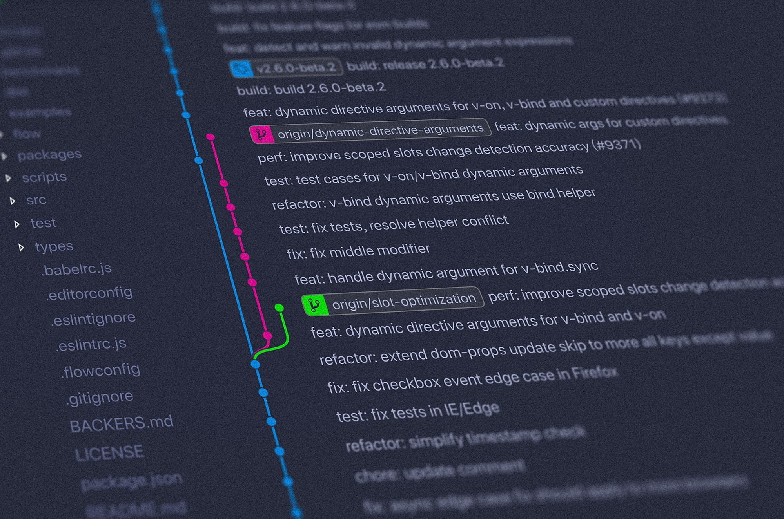







What is GitHub?
Version Control
Pull request
GitHub is a web-based hosting service for version control using Git. It provides a platform for developers to collaborate on software projects, share code, track issues and bugs, and contribute to open-source projects.
Collaboration
Integration
Issue Tracking

Slide 17





GitHub Workflow
Add Commits
Discuss and Review
Open a Pull Request
Merge and Deploy
Create a Branch
Create a branch in your project where you can safely experiment and make changes
Use a pull request to get feedback on your changes from people down the hall or ten times zones away
Merge your changes into your master branch and deploy your code
Commit
Comment on pull request
Close pull request
Compare
Add Issues/resolve issues mention individuals
Sync or push to branch

Slide 18
Git & GitHub Hands-on

Slide 19
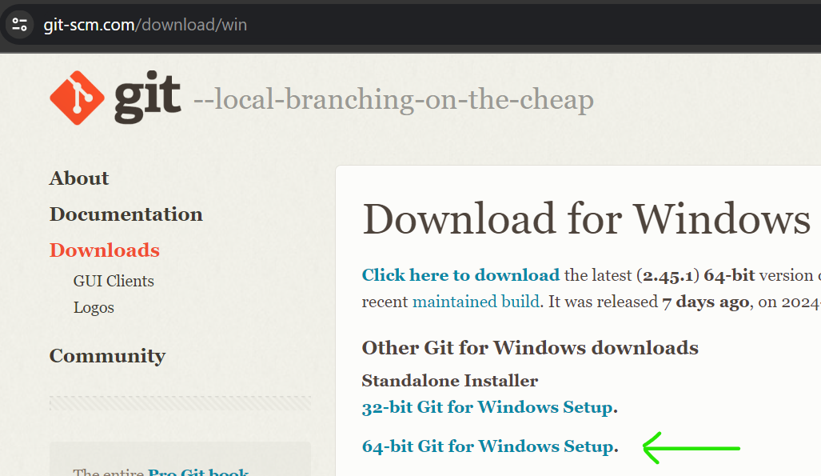
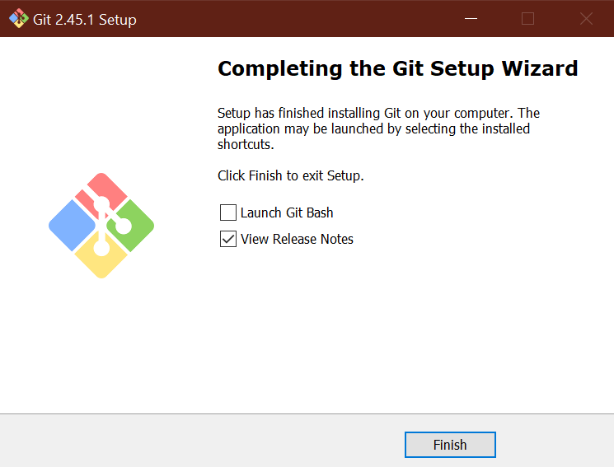
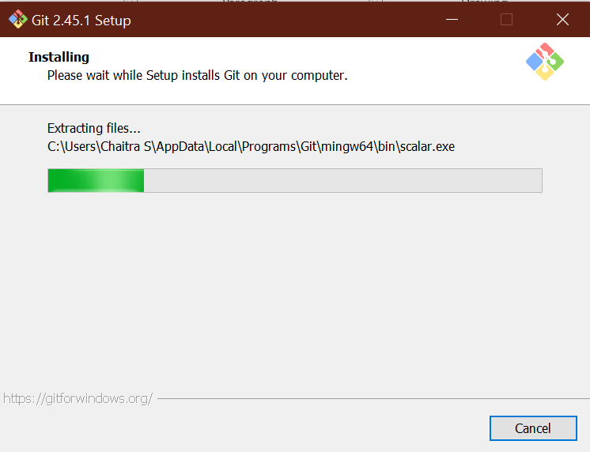
Install Git on Windows
The download page: https://git-scm.com/download/win
Step 1: Download the exe file.
Step 2: Let the configurations be at default. Click on ‘next’ for almost everything and finally click on ‘install’
Step 3: Click on ‘Finish’ and open ‘Git bash’.

Slide 20







Git Commands
The git push command is used to upload local repository changes to a remote repository
git push
The git init command is used to initialize a new Git repository in a directory
git init
The git clone command is used to create a copy of an existing Git repository in a new directory on our local machine
git clone
The git add command is used to add files to the staging area in Git
git add
The git status command is used to display the current state of your local Git repository
git status
The git commit command is used to create a new commit in Git
git commit
The git log command is used to display the commit history of a Git repository
git log

Slide 21
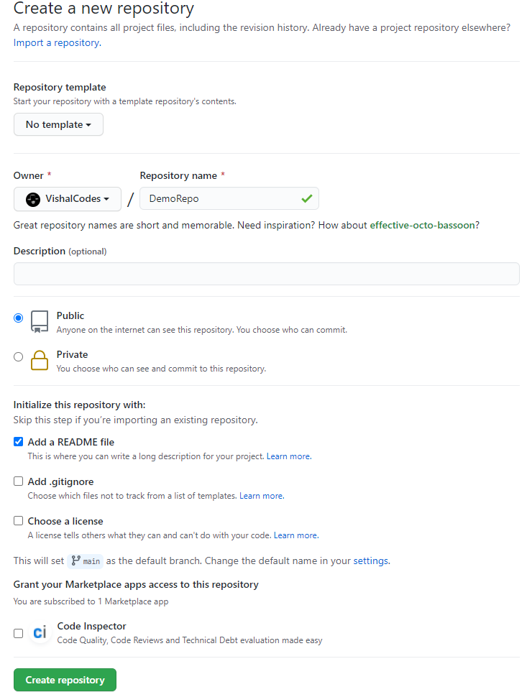
GitHub Tasks
Step 1. Create a Repository
A repository is usually used to organize a single project. Repositories can contain folders and files, images, videos, spreadsheets, and data sets – anything your project needs.
To create a new repository
In the upper right corner, next to your avatar or identicon, click and then select New repository.
Name your repository “he
Write a short description.
Select Initialize this repository with a README.

Slide 22
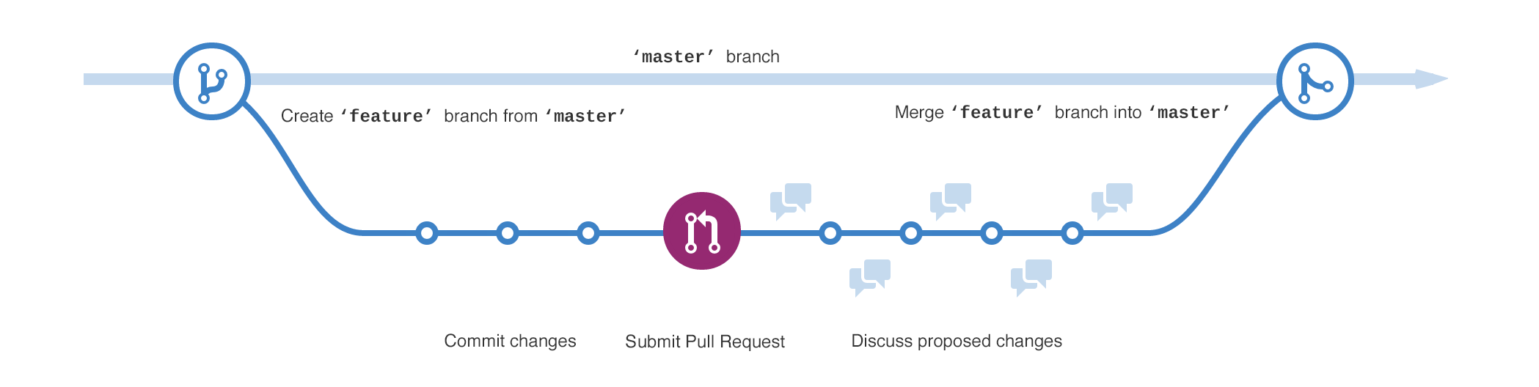
Step 2. Create a Branch
Branching is the way to work on different versions of a repository at one time.
By default our repository has one branch named “main” which is considered to be the definitive branch.
We use branches to experiment and make edits before committing them to ”main”.
When you create a branch off the main branch, you’re making a copy, or snapshot, of main as it was at that point in time.
If someone else made changes to the main branch while you were working on your branch, you could pull in those updates.
This diagram shows:
The main branch
A new branch called feature (because we’re doing ‘feature work’ on this branch).
The journey that feature takes before it’s merged into main

Slide 23
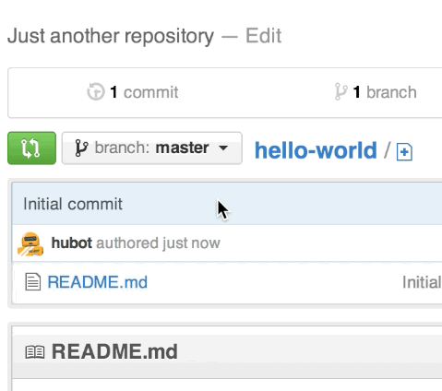
To create a new branch
Go to your new repository hello-world
Click the drop down at the top of the file list that says branch: main.
Type a branch name, readme-edits, into the new branch text box.
Select the blue Create branch box or hit “Enter” on your keyboard.

Slide 24
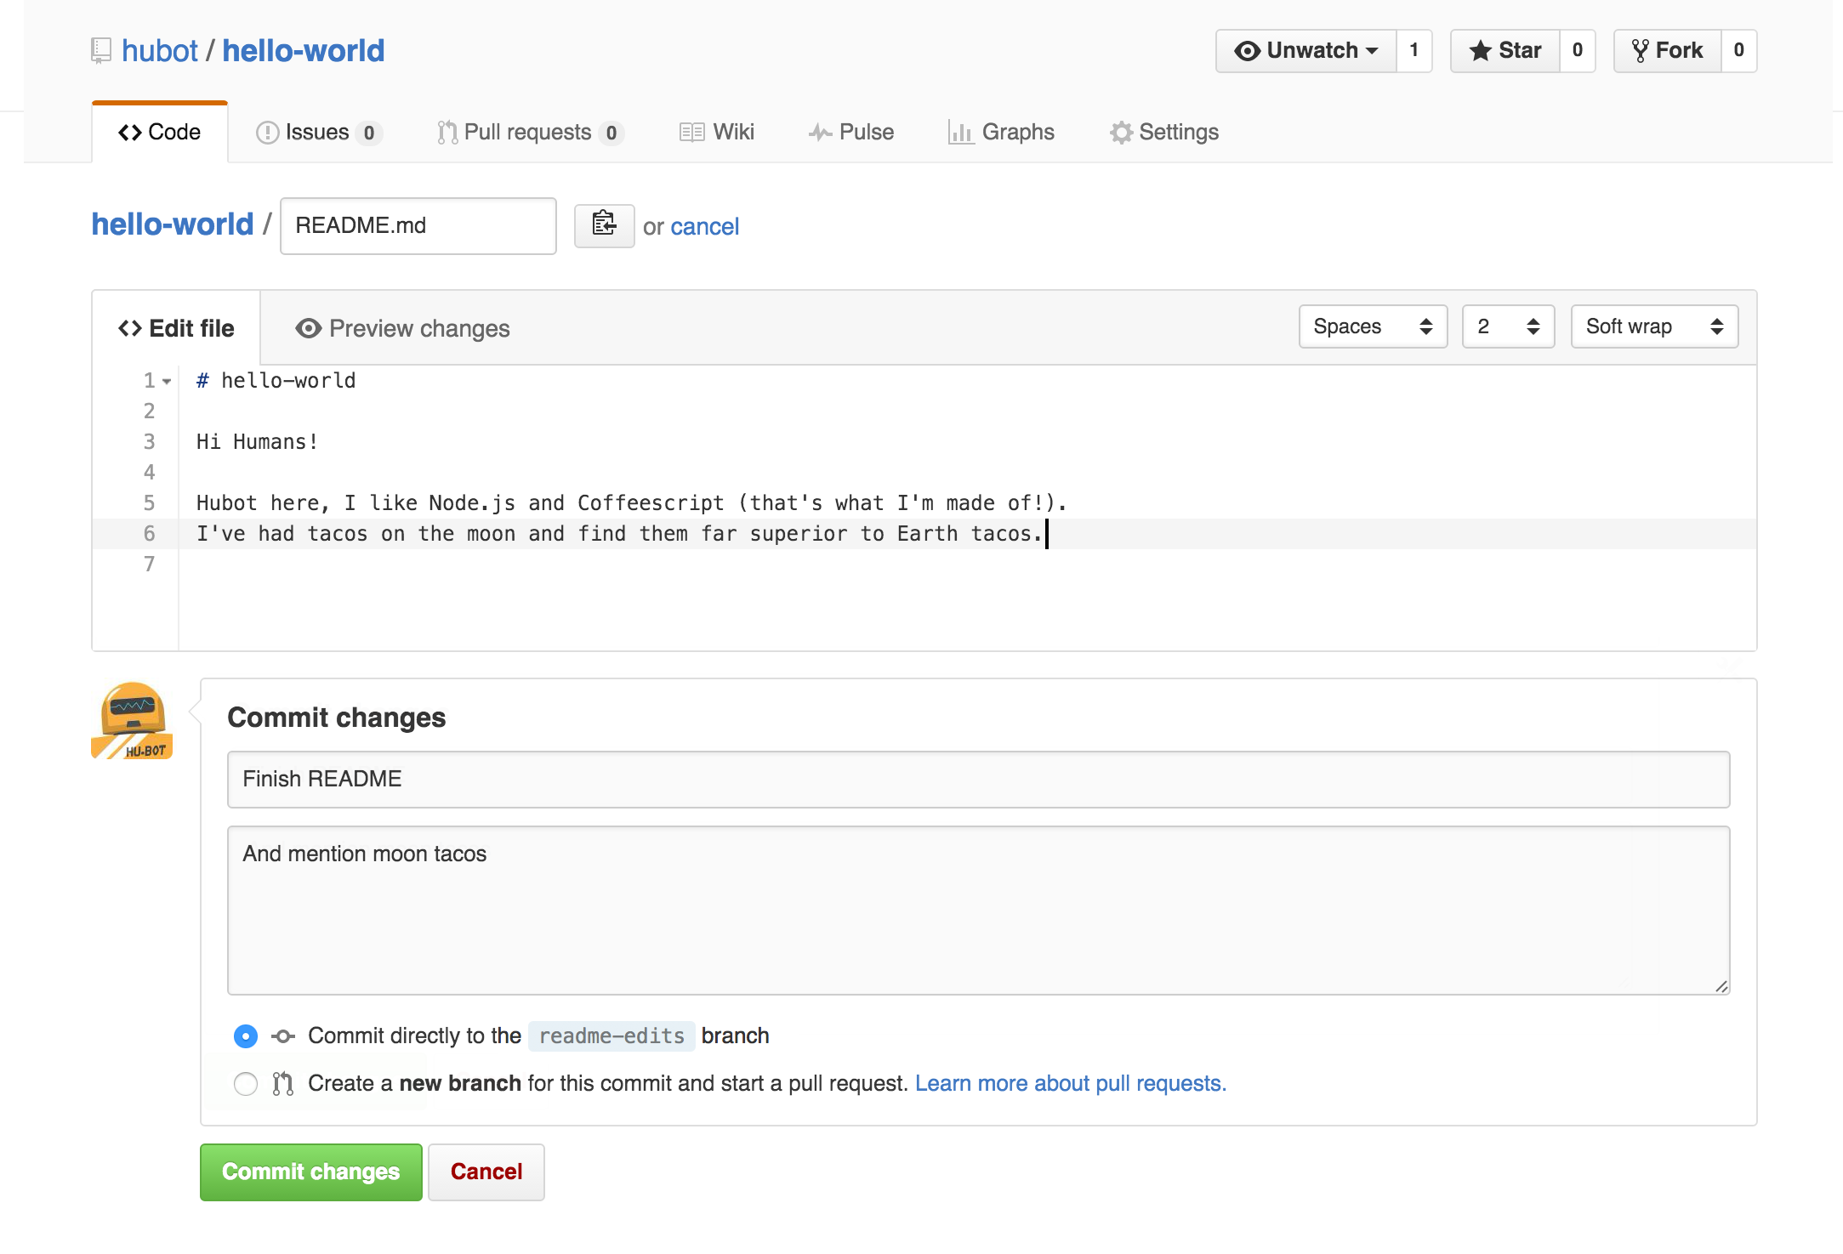
Step 3. Make and commit changes
On GitHub, saved changes are called commits. Each commit has an associated commit message, which is a description explaining why a particular change was made.
Commit messages capture the history of your changes, so other contributors can understand what you’ve done and why.
Make and commit changes
Click the README.md file.
Click the pencil icon in the upper right corner of the file view to edit.
In the editor, write a bit about yourself.
Write a commit message that describes your changes.
Click Commit changes button.
Note: These changes will be made to just the README file on your readme-edits branch, so now this branch contains content that’s different from main.

Slide 25
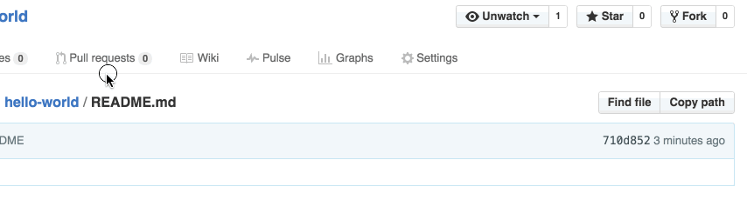
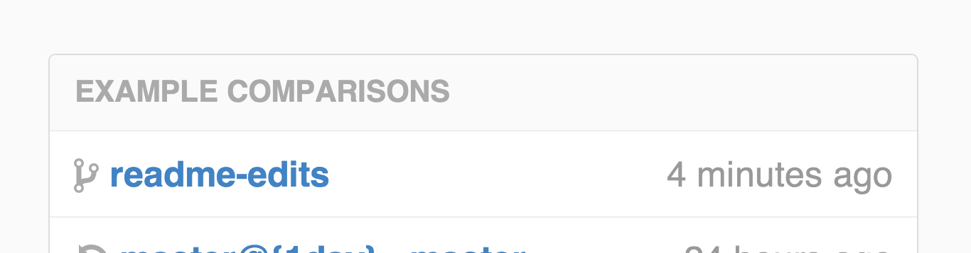
Step 4. Open a Pull Request
Pull Requests are the heart of collaboration on GitHub. When you open a pull request, you’re proposing your changes and requesting that someone review and pull in your contribution and merge them into their branch.
Pull requests show diffs, or differences, of the content from both branches. The changes, additions, and subtractions are shown in green and red.
Open a Pull Request for changes to the README :
Click the Pull Request tab, then from the Pull Request page, click the green New pull request button.
In the Example Comparisons box, select the branch you made, readme-edits, to compare with main

Slide 26
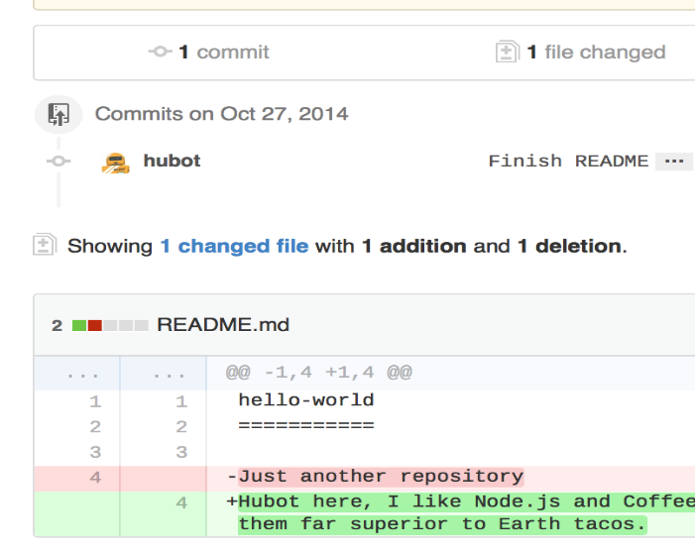
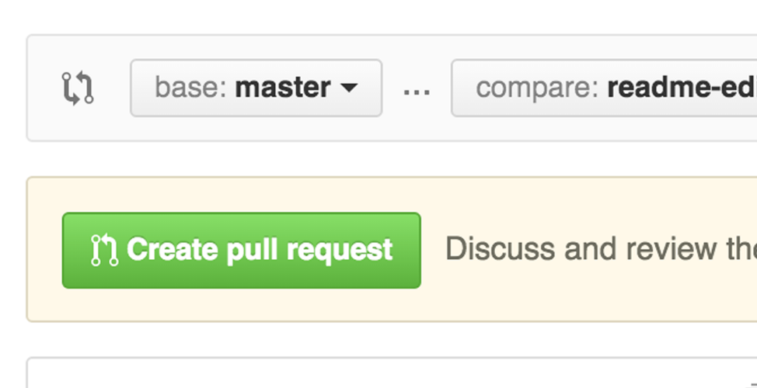
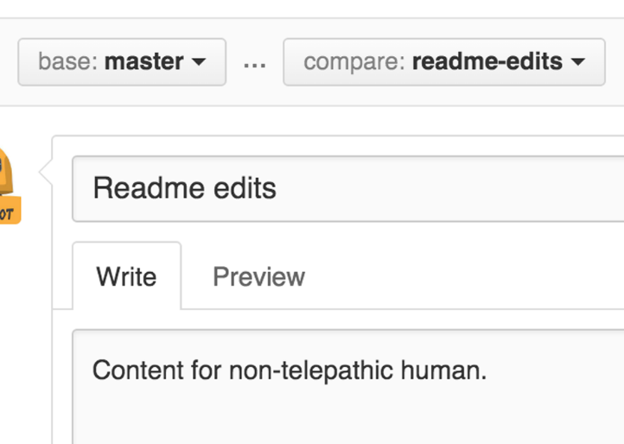
Look over your changes in the diffs on the Compare page, make sure they’re what you want to submit.
When you’re satisfied that these are the changes you want to submit, click the big green Create Pull Request button.
Give your pull request a title and write a brief description of your changes.

Slide 27
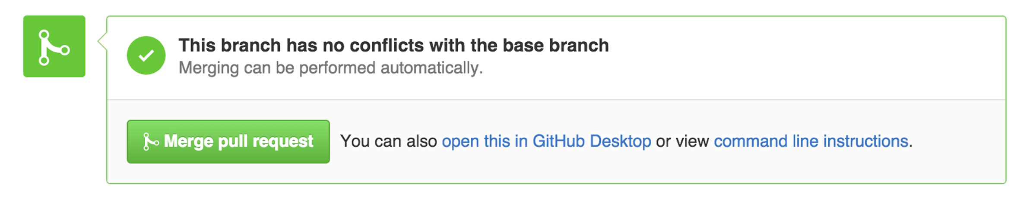
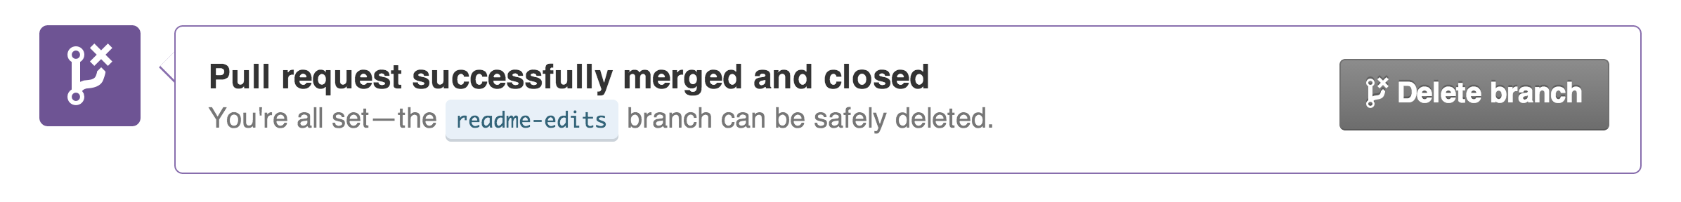
Step 5. Merge your Pull Request
Click the green Merge pull request button to merge the changes into main.
Click Confirm merge.
Go ahead and delete the branch, since its changes have been incorporated, with the Delete branch button in the purple box.

Slide 28
Git Vs GitHub
Git | GitHub
Git is software. | It is a service.
Linux maintains Git. | Microsoft maintains GitHub.
It is a command-line tool. | It is a graphical user interface.
You can install it locally on the system. | It is hosted on the web. It is exclusively cloud-based.
It is a VCS to manage source code history. | It is a hosting service for Git repositories.
It focuses on code sharing and version control. | It focuses on centralized source code hosting.
It lacks a user management feature. | It has a built-in user management feature.
Git was launched in 2005. | GitHub was released in 2008.
Git has minimum external tool configuration. | It has an active marketplace for tool integration.
It is open-source licensed. | It has a free-tier and pay-for-use tier.
Its desktop interface is named Git Gui. | Its desktop interface is named GitHub Desktop.

Slide 29
THANK
YOU.
Notes:
https://www.freepik.com/

